Slide 1
NON-CARIOUS LESIONS

Slide 2
INTRODUCTION
Although decay is the usual cause of tooth destruction necessitating operative procedures, about 25% of tooth destruction does not originate from caries process.

Slide 3
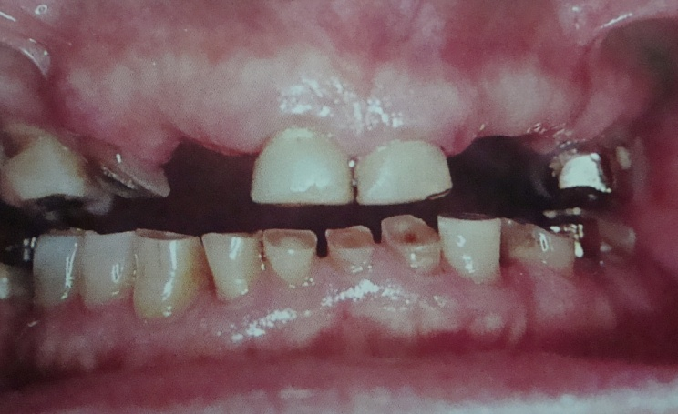
Definition:
Mechanical wear of incisal or occlusal surfaces of tooth as a result of functional or parafunctional movements of mandible.
Frictional forces between contacting teeth.
Continuous and age dependent, Physiologic process.
ATTRITION

Slide 4
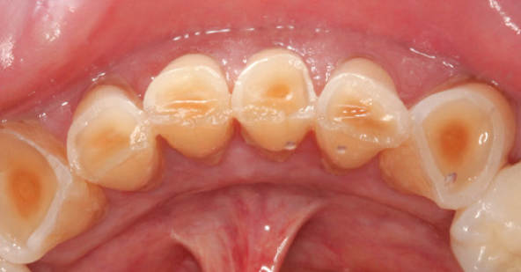
Etiology:
Bruxism – due to stress
sleep apnoea
airway issues
Coarse diet
Natural teeth opposing porcelain

Slide 5

Clinical features:
Occlusal surface attrition:
Loss, flattening, faceting or reverse cusping of occluding elements → loss of the vertical dimension of the tooth.
Severe, generalized and short period of time→ no chance for the alveolar bone to erupt occlusally to compensate for the occlusal tooth loss.
Craze lines limited to enamel.

Slide 6
Long period of time, the alveolar bone grow occlusally, bringing the teeth to their original termination.
Vertical dimension loss →confined to the teeth, not imparted to the face.
Underlying dentin susceptible to decay
check biting (cotton roll cheeks) – sequelae of occlusal wear.

Slide 7
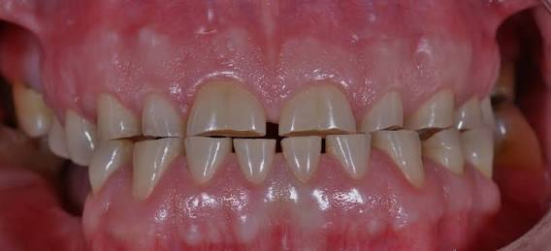
Proximal surface attrition:
Surface tooth structure loss , flattening, widening of proximal areas.
Reduced Mesio-distal dimensions of teeth → drifting, overall reduction of the arch length.
Reduced interproximal space → physiology of dental papilla→ periodontitis.

Slide 8
Symptoms:
Tooth hypersensitivity due to
Dentin exposure
Microcracks
Stagnation of irritant substances
Pulpal and apical strangulation due to excessive non-physiologic forces
Tearing of periodontal ligament

Slide 9
Treatment modalities for attrition:
Pulpally involved teeth →endodontic therapy or extracted.
Disoccluding devices like biteplanes and occlusal splints → control parafunctional habits.
Selective grinding- smoothening of periphery of occlusal tables.
Protection of exposed sensitive dentin – fluoride solution.
Myo-functional, TMJ disorders →diagnosed and resolved.
Carious lesion – small- amalgam/direct gold or cast alloy.

Slide 10
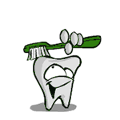
Definition:
Abnormal tooth surface loss resulting from direct forces of friction between teeth and external objects or from frictional forces between contacting teeth components in the presence of an abrasive medium.
ABRASION

Slide 11
Etiology:
Improper brushing habit:
Brushing technique – Horizontal,
Brushing force
Bristle stiffness
silica abrasive,
high percentage of abrasives in dentifrice.

Slide 12
Habitual chewing on hard objects (e.g. paper clips, pens, pencils)
Pipe smoking – depression on occluding surfaces of latero-anterior portion.
Iatrogenic – dentures with porcelain teeth – opposing natural teeth.
Pica syndrome – chewing clay/mud.

Slide 13
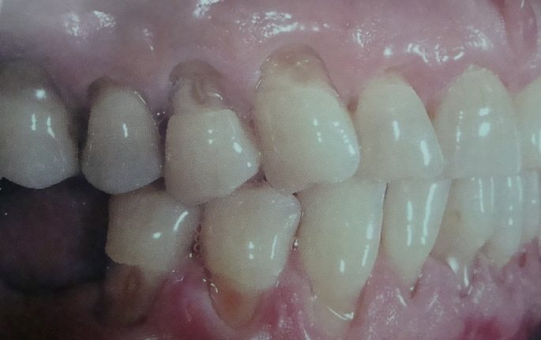
Clinical signs and symptoms :
Lesions may be linear in outline
Extremely smooth surface
Peripheries of the lesion - angularly demarcated from the adjacent tooth surface
Probing or stimulating the lesion →elicit pain

Slide 14
Treatment modalities for abrasion:
Diagnose the cause → eliminate the etiological factor.
Prevent the patient from practicing causative habits.
Desensitization of the hypersensitive → fluoride solution application (8- 30% sodium or stannous fluorides for 4- 8 minutes).
Restorative treatment - 0.5mm in dentin − do not require any restoration.
If the lesion is > 0.5mm into dentin (V-shaped), then it should be restored.

Slide 15
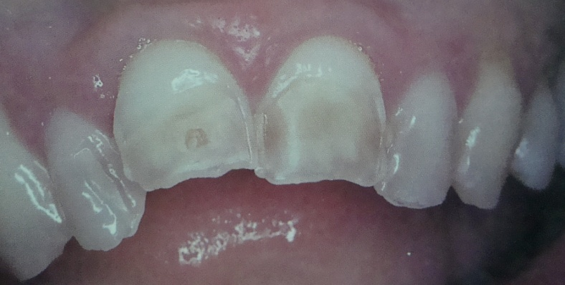
Definition: Wear or loss of tooth surface by chemical action in the
continued presence of demineralizing agents with low pH.
Classification based on etiology:
Recurrent vomiting – eating disorders – 20-30 years
a)Bulimia nervosa – self induced vomiting
b)anorexia nervosa – extreme dietary restriction and profound weight loss.
EROSION
Intrinsic Erosion
(endogenous acids of gastric origin)

Slide 16
Gastro esophageal reflux disease (GERD)
Medical conditions
a) Gastric disorders – peptic ulcers, intestinal obstructions
b) Metabolic and endocrine disorders
c) Neurological disorders – psychogenic vomiting syndrome, chronic alcoholism, pregnancy induced vomiting.
- Rumination – in young infants

Slide 17
- Occupational factors: Professional wine tasters and professional swimmers
- Diet: Citrus fruit juices, acidic beverages and carbonated beverages
- Medicaments: Aspirin and ascorbic acid (vitamin C)
- Lifestyle
Extrinsic Erosion (associated with extrinsic factors)

Slide 18
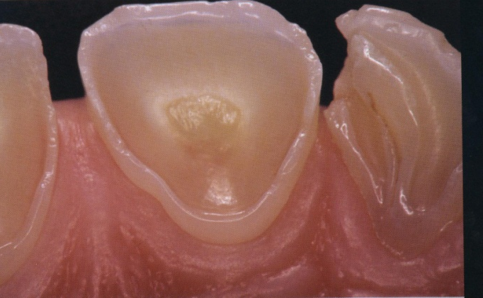
Clinical features:
Lingual surfaces of upper teeth, facial surfaces of posterior teeth.
No demarcation between lesion and adjacent tooth surface.
Lesion – glazed.
Gingiva, periodontium – sound, healthy.
Tooth sensitivity.

Slide 19
Treatment modalities:
Analysis of diet, habits.
Preoperative study models, photographs.
Metallic restorations – more resistant.
If deep erosion lesions – bonded restorations.

Slide 20
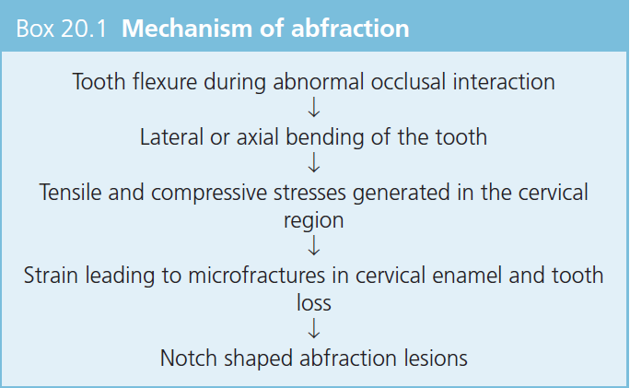
Definition: Strong eccentric occlusal force resulting in microfractures at the cervical area of the
tooth causing wedge shaped defects.
Etiology:
Tooth flexure in patients with abnormal occlusal interactions
ABFRACTION

Slide 21
CLINICAL FEATURES:
- Sharp notch or wedge shaped lesions instead of the saucer-shaped defects associated with other non-carious cervical lesions.
- The maximal abfractive stresses generated are at the cervical area in the thinnest region of enamel at the cementoenamel junction (CEJ).
- These forces can also cause the loss of bonded Class V restorations in preparations with no retention grooves.

Slide 22
Treatment modalities:
Adjust the bite - Chewing forces → evenly distributed among all the teeth.
Restoring the damage by bonding a filling in place like composites, compomers, GIC, RMGIC.
Composites –low elastic modulus – accommodate flexural forces.
Early treatment → prevents further damage and restores teeth to their normal shape and color.
In aesthetically demanding cases, a RMGIC⁄GIC liner be laminated with resin composite.

Slide 24
Chemical cure glass ionomer

Slide 25
Resin modified glass ionomer

Slide 26
Careful evaluation of the site should be performed to determine the appropriate treatment:
I. Restoration
II. Soft tissue coverage (graft)
III. Combined approach
If lesion located in enamel, soft tissue coverage not recommended.

Slide 27
Miller classification

Slide 28
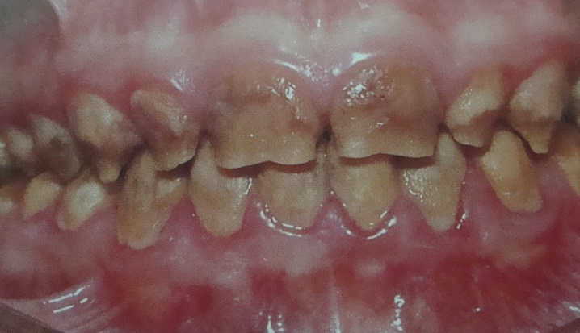
Abnormalities on genes – formation of enamel.
Autosomal dominant.
Features:
Thin enamel – easily chips off, soft
Open contact
Easily worn
Yellow/black discoloration
AMELOGENESIS IMPERFECTA

Slide 29
Treatment modalities:
- Early diagnosis → key to a successful treatment
- Selective odontotomy for esthetically reshaping the teeth
- Conservative non-restorative treatment → tried first, before resorting to restorative procedures.
- If enamel defects are not associated with dentinal defects → restorative prognosis is favourable
Porcelain veneers or cast ceramic restorations

Slide 30
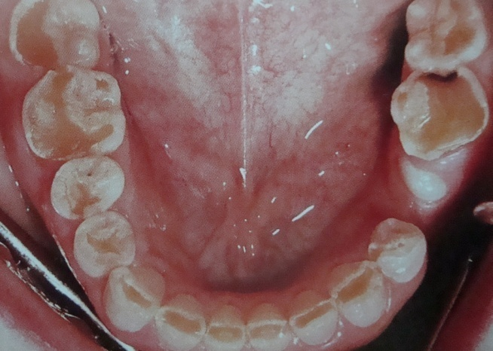
- Dentinogenesis imperfecta is a genetically dictated class of disease, affecting the formation and/or maturation of the dentin matrix.
- 8 types- Hereditary opalescent dentin common.
Features:
Grey, yellow-brown, violet.
Enamel chipped easily – defective DEJ.
Roots short, slender.
If decay present – spreads laterally.
Dentin devoid of dentinal tubules.
Root canal/pulp chamber obliterated.
DENTINOGENESIS IMPERFECTA

Slide 31
Treatment modalities:
Success for treatment depends upon early diagnosis and care
No attempt to use intracoronal or intraradicular retention modes
The only retention possible is extracoronal reinforcing protecting veneering restorations
Cast metal crowns → posterior teeth and
Jacket crowns → anterior teeth

Slide 32
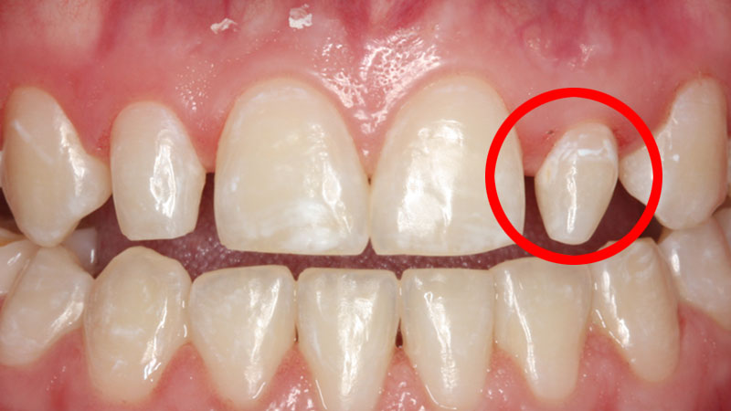
Hereditary in origin
Common – upper lateral – peg lateral
MALFORMATIONS

Slide 33
Treatment modalities:
If affected tooth properly aligned – intact enamel – no excessive occlusal loading – conditioning – direct tooth coloured resin.
If affected teeth malaligned – repositioning should be done before restorative treatment.
If affected teeth do not have sufficient enamel – PFM/ ceramic veneers.

Slide 34
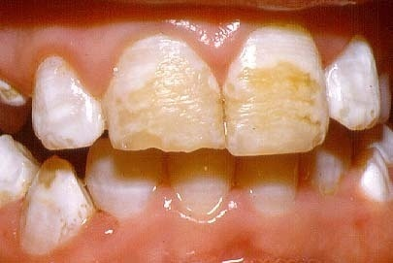
Ameloblasts – enamel forming cells
If irritated – defective enamel matrix formation.
Etiology:
Nutritional deficiencies
Exanthematous diseases
In congenital syphilis
Fluorides
LOCALIZED ENAMEL HYPOPLASIA

Slide 35
Treatment modalities:
- Minimum size defects→selective odontotomy ,blending the defects with the remaining tooth surfaces.
- Restorations with direct tooth colored materials without any mechanical preparation.
- If the defect is at the occluding or contacting area, it is necessary to resort to metallic or cast restorations.
- Vital bleaching.

Slide 36
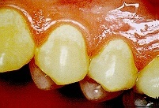
Defective mineralization of matrix.
Affected areas – appear chalky and soft.
Very stainable.
Extensive – attrition, abrasion.
LOCALIZED HEREDITARY ENAMEL HYPOCALCIFICATION

Slide 37
Treatment modalities:
No attempt should be made for localized odontotomy, etching restorations, or non-veneering types of restorations.
If uncalcified areas are small →attempts to mineralize the tooth enamelperiodic fluoride applications, and strict prevention of plaque accumulation in these areas.
laminated veneering, composite veneering and porcelain fused to metal and cast ceramic crowns.

Slide 38
Injury or destruction of the odontoblast cells → deficient or complete absence of dentin matrix deposition.
Odontoblasts are replaceable cells
If they disappear, there will be no dentin temporarily, dentin deposition resume as soon as other pulp cells start depositing it.
If these defects are encountered during tooth preparation for a restoration
Treatment - intermediary basing, an additional dimension to that part of the tooth preparation that is going to be restored.
LOCALIZED DENTIN HYPOPLASIA

Slide 39
- Same causes as hypolasia.
- The dentin will be present but softer, more penetrable and less resilient.
- These defects if encountered during tooth preparation treated by proper intermediary basing
LOCALIZED DENTIN HYPOCALCIFICATION

Slide 40
In young patients – remnants of nasmyths membrane (green discolouration),
poor oral hygiene, eating habits.
In older patients – brown, black – poor oral hygiene, coffee
tea and other chromogeneic foods or medications.
- Tobacco stains
DISCOLOURATIONS
Extrinsic

Slide 41
Treatment modalities:
Mostly can be removed by prophylactic procedures.
Conservative correction – mild micro abrasion - 5 HCl, 5 H₂O₂, 1 Ether (Mc innes solution).
Macro abrasion – flame shaped, carbide finishing bur.
Polishing with abrasive discs or points.
Tobacco stains Pumicing with rubber cups

Slide 42
Intrinsic
Discoloration due to tissues of the tooth.
Vital tooth discolouration
Hereditary disorders
Tetracycline
Fluoride
Poor oral hygiene

Slide 43
Non-vital Discolouration:
Decomposition of pulp tissue
Trauma
- Excessive hemorrhage following pulp extirpation
Calcific metamorphosis
Filling materials
Aging
Iatrogenic discolorations

Slide 44
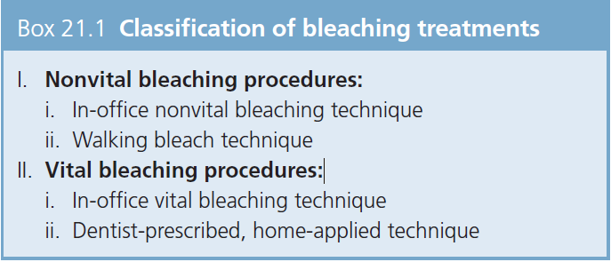
Treatment modalities:
  Bleaching

Slide 45
In office non-vital bleaching – 35% Hydrogen peroxide
Walking bleaching technique – Sodium perborate
Walking bleaching technique

Slide 46
In office vital bleaching – 30-35% hydrogen peroxide
At home bleaching – 10-15% Carbamide peroxide

Slide 47
Non-carious tooth defects continue to be a matter of great concern. Multifactorial etiology has made recognition of casual factors in individual patients quite problematic and thereby the prevention and treatment of lesions has also remained haphazard. Adequate preventive and/or restorative measures need to be instituted to attain high levels of success.
CONCLUSION

